Slide 1

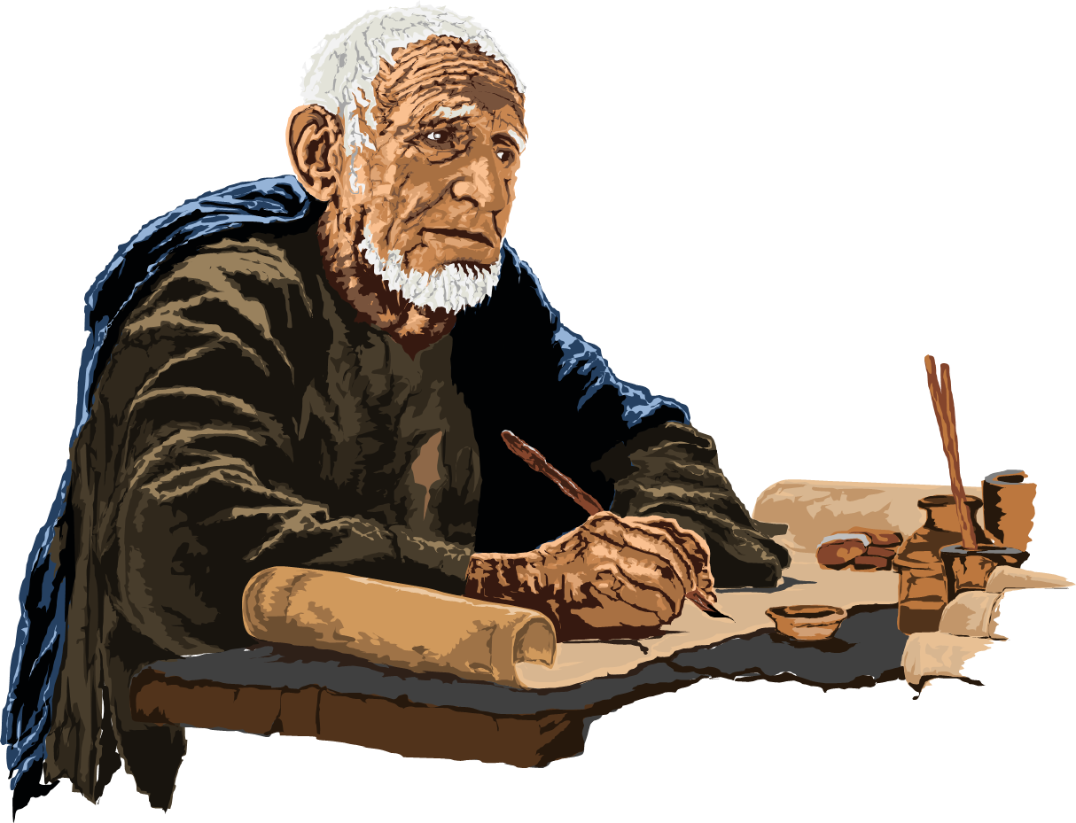

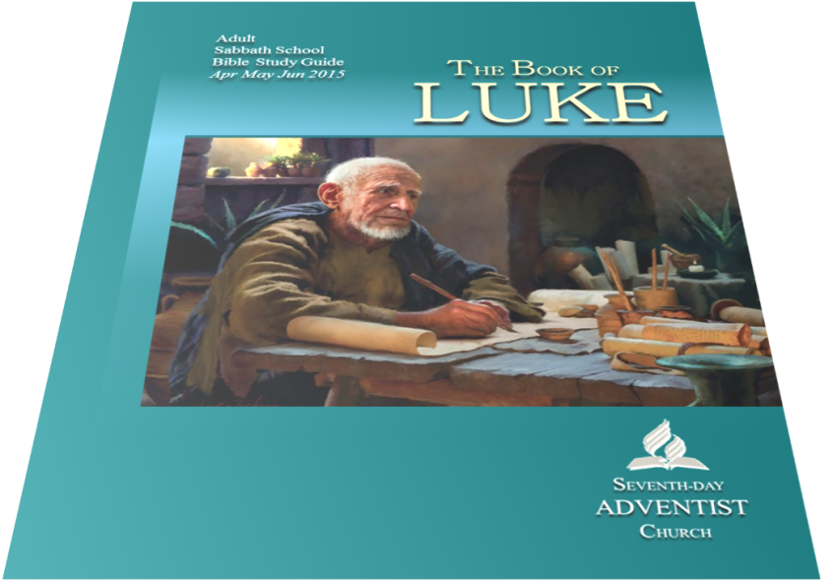


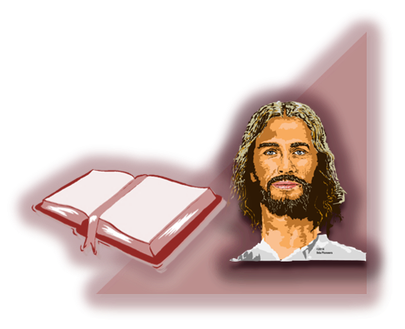

sdapioneers@hotmail.com
2nd Quarter 2015
Crucified
and Risen
13
June 20 – June 27 - 2015

Slide 2
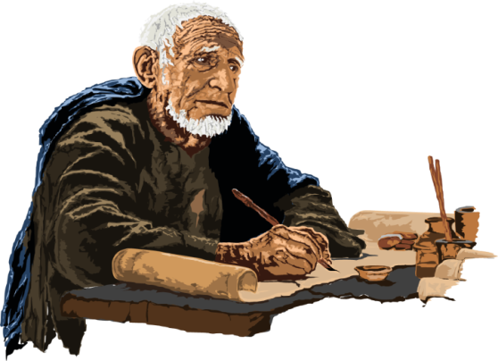






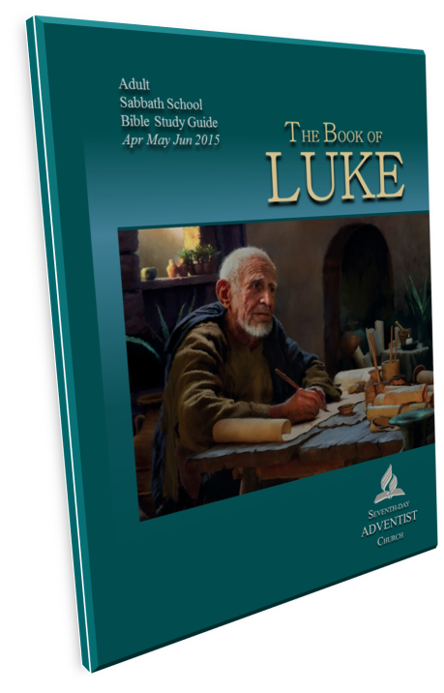
sdapioneers@hotmail.com
THE BOOK OF LUKE – Lesson 13 – 2nd QUARTER 2015
Crucified and Risen
Memory / Key Text:
“ ‘The Son of Man must be
delivered into the hands of sinful men, and be crucified,
and the third day rise again’ ”
Luke 24:7
13
SABBATH AFTERNOON

Slide 3
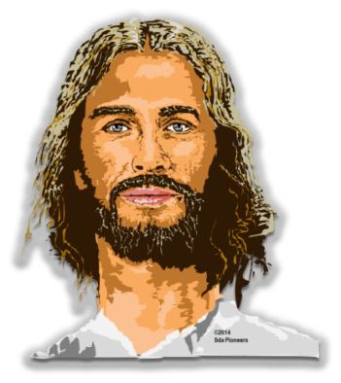
sdapioneers@hotmail.com
THE BOOK OF LUKE – Lesson 13 – 2nd QUARTER 2015
Crucified and Risen
The Lesson in Brief :
Know:
The Sufferings and the Victory
of Jesus
What is the cup that Jesus wanted taken away from Him? How did the cross, an instrument of shame, become a symbol of salvation? Why was a bodily resurrection of Jesus necessary?
13
SABBATH AFTERNOON

Slide 4
sdapioneers@hotmail.com
THE BOOK OF LUKE – Lesson 13 – 2nd QUARTER 2015
Crucified and Risen
The Lesson in Brief :
Feel:
The Agony and the Victory of Jesus
How do you react to Gethsemane
—to the indifference of the sleeping disciples,
to the agony of Jesus? Imagine yourself at the foot of the cross. How might that have affected your attitude toward sin?
13
SABBATH AFTERNOON

Slide 5
sdapioneers@hotmail.com
THE BOOK OF LUKE – Lesson 13 – 2nd QUARTER 2015
Crucified and Risen
The Lesson in Brief :
Do:
Identify With the Crucified and
Risen Jesus.
What would you do or give in return for the great sacrifice Jesus gave for your sins? How would you express your thankfulness for the love manifested on the cross?
13
SABBATH AFTERNOON

Slide 6
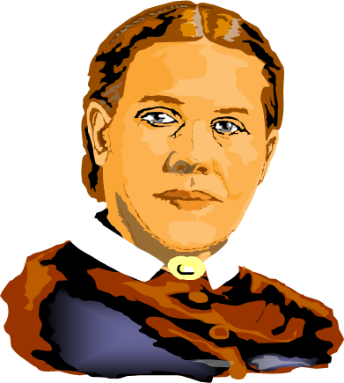
sdapioneers@hotmail.com
THE BOOK OF LUKE – Lesson 13 – 2nd QUARTER 2015
Crucified and Risen
Quote Ellen G. White
The forgiveness of sins is not the sole
result of the death of Jesus. He made
the infinite sacrifice, not only that sin might
be removed, but that human nature might
be restored, rebeautified, reconstructed
from its ruins, and made fit
for the presence of God.
{5T 537}
13
SABBATH AFTERNOON

Slide 7
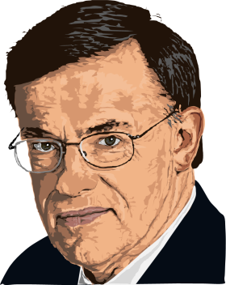
sdapioneers@hotmail.com
THE BOOK OF LUKE – Lesson 13 – 2nd QUARTER 2015
Crucified and Risen
Sabbath School on the Move
by Jonathan Gallagher
Why is it so important to make sure we always speak of the resurrection as well as the cross?
How does the cross and resurrection show God’s true nature?
Questions
13
SABBATH AFTERNOON

Slide 8

sdapioneers@hotmail.com
THE BOOK OF LUKE – Lesson 13 – 2nd QUARTER 2015
Gethsemane: The Fearsome Struggle
Compare
what happened in Eden
(Gen. 3:1–6)
with what happened
in Gethsemane
(Luke 22:39–46).
What was the big difference
in what happened
in both gardens?
13
SUNDAY

Slide 9
sdapioneers@hotmail.com
THE BOOK OF LUKE – Lesson 13 – 2nd QUARTER 2015
Gethsemane: The Fearsome Struggle
Next time you are severely tempted, how can you have the kind of experience Jesus had in Gethsemane
as opposed to what Adam and Eve
had in Eden? What is the crucial
factor that makes all the
difference between them?
13
SUNDAY

Slide 10



sdapioneers@hotmail.com
THE BOOK OF LUKE – Lesson 13 – 2nd QUARTER 2015
Judas
“Then Satan entered Judas, called Iscariot,
one of the Twelve”
(Luke 22:3).
No doubt Satan worked hard to get all the disciples. What was it about Judas, though, that enabled the adversary to succeed so well with him, in contrast to the others?
13
MONDAY

Slide 11
sdapioneers@hotmail.com
THE BOOK OF LUKE – Lesson 13 – 2nd QUARTER 2015
Judas
There is nothing wrong with status, power, or money. The problem comes when these things (or anything) overshadow our faithfulness to God. Why is it always important to
take stock of ourselves so
that we don’t become as
self-deceived as was Judas?
13
MONDAY

Slide 12

sdapioneers@hotmail.com
THE BOOK OF LUKE – Lesson 13 – 2nd QUARTER 2015
Either for Him or Against Him
How
did the following people relate to Jesus, and
what lessons can we
learn from their examples that can help us in our own relationship
to God and how we
relate to the Cross?
13
TUESDAY

Slide 13
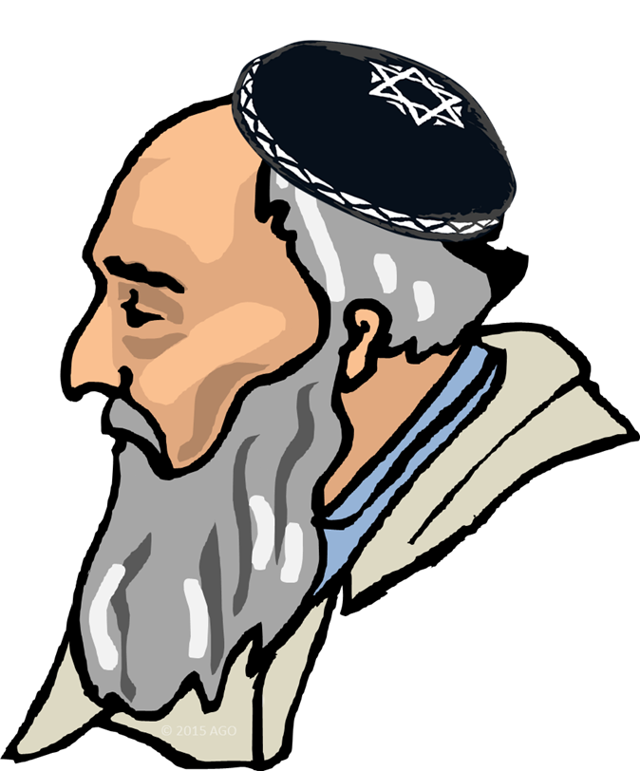
sdapioneers@hotmail.com
THE BOOK OF LUKE – Lesson 13 – 2nd QUARTER 2015
Either for Him or Against Him
Sanhedrin (Luke 22:53). What mistakes did these people make, why
did they make them, and how can we protect ourselves from doing
something similar concerning how they viewed Jesus?
13
TUESDAY

Slide 14
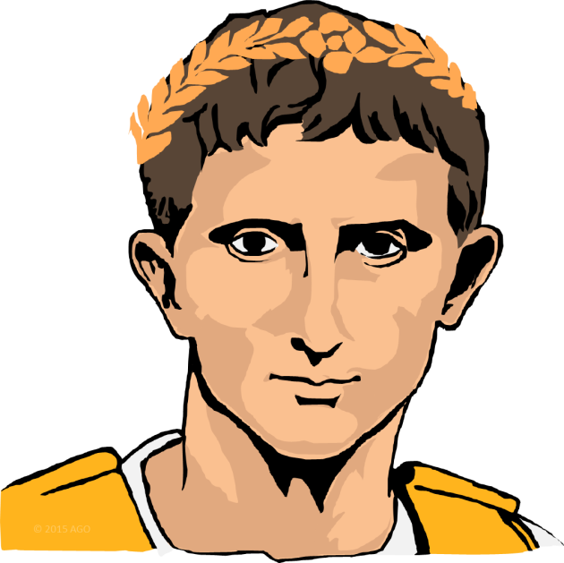
sdapioneers@hotmail.com
THE BOOK OF LUKE – Lesson 13 – 2nd QUARTER 2015
Either for Him or Against Him
Pilate
(Luke 23:1–7, 13–25).
What led Pilate to say,
“ ‘I find no fault
in Him’ ” (John 19:4,)
and at the same time sentence Him to be crucified? What can
we learn from his
mistake in failing to do
what he knew was right?
13
TUESDAY

Slide 15
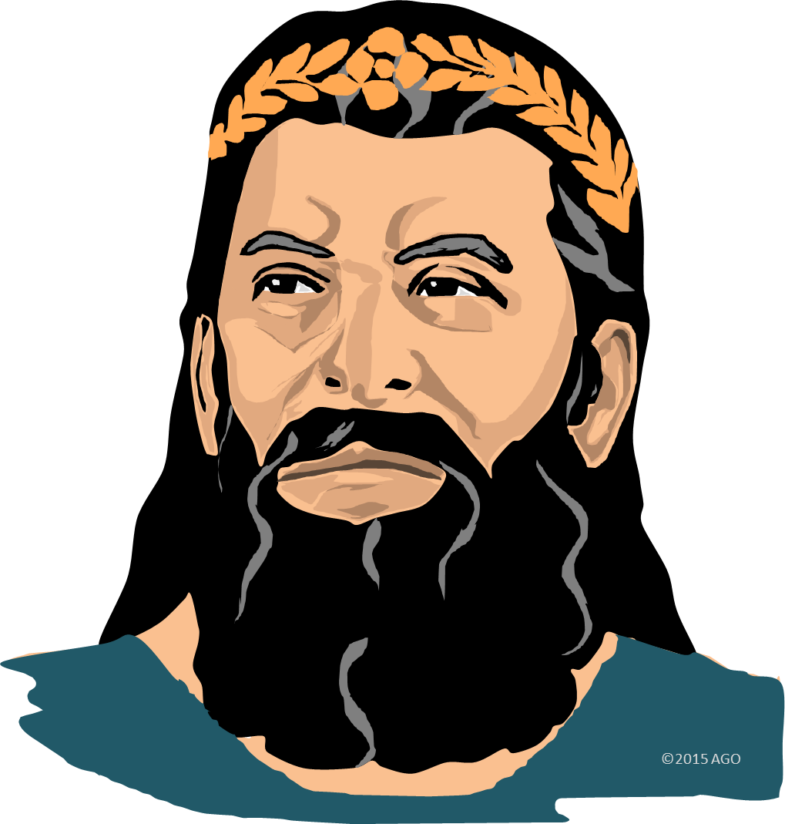
sdapioneers@hotmail.com
THE BOOK OF LUKE – Lesson 13 – 2nd QUARTER 2015
Either for Him or Against Him
Herod
(Luke 23:6–12).
What was his
big mistake,
and what can we
learn from it?
13
TUESDAY

Slide 16

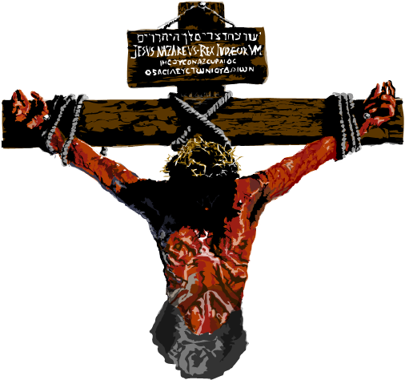
sdapioneers@hotmail.com
THE BOOK OF LUKE – Lesson 13 – 2nd QUARTER 2015
Either for Him or Against Him
The two thieves
(Luke 23:39–43).
Two sinners look at the same cross and have two different reactions. How does this scene reveal
the either-or aspect of salvation—that is, we are either on one side of
the great controversy or on the other?
13
TUESDAY

Slide 17
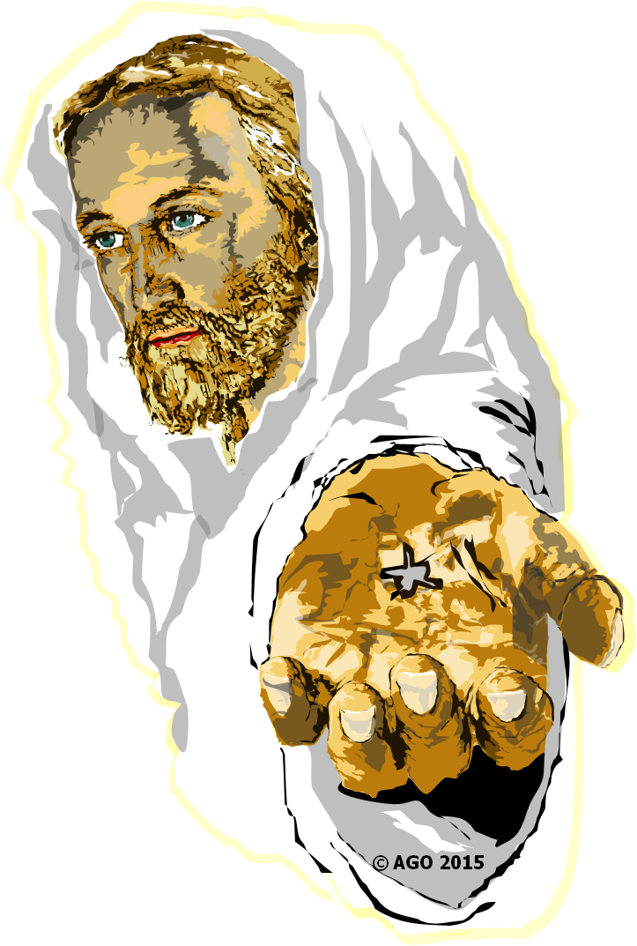
sdapioneers@hotmail.com
THE BOOK OF LUKE – Lesson 13 – 2nd QUARTER 2015
He Is Risen
In
the first few chapters
of Acts alone there
are at least eight references
to the resurrection
of Jesus
(see Acts 1:22; 2:14–36; 3:14, 15; 4:1, 2,
10, 12, 33; 5:30–32).
13
WEDNESDAY - 1

Slide 18
sdapioneers@hotmail.com
THE BOOK OF LUKE – Lesson 13 – 2nd QUARTER 2015
He Is Risen
Why was
the resurrection
of Jesus so pivotal
in apostolic preaching
and in the faith of the early church?
Why is it still so crucial
for us today, as well?
13
WEDNESDAY - 2

Slide 19
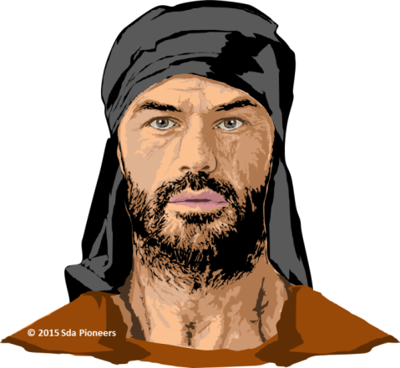
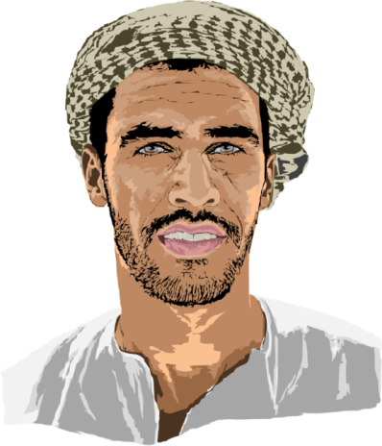
sdapioneers@hotmail.com
THE BOOK OF LUKE – Lesson 13 – 2nd QUARTER 2015
“All Things Must Be Fulfilled”
Read
Luke 24:13–49,
which tells us about
events immediately after
Christ’s resurrection.
In the various encounters,
what does Jesus point to in
order to help these people
understand what happened
to Him, and why
is that so important, even for
us today in our witness to the world?
13
THURSDAY

Slide 20
sdapioneers@hotmail.com
THE BOOK OF LUKE – Lesson 13 – 2nd QUARTER 2015
“All Things Must Be Fulfilled”
How much time do you
spend with the Bible?
How does it impact
how you live, the choices
you make, and how
you treat others?
13
THURSDAY

Slide 21

sdapioneers@hotmail.com
THE BOOK OF LUKE – Lesson 13 – 2nd QUARTER 2015
Further Study:
Quote Ellen G. White
“The significance of
the death of Christ will be seen by
saints and angels. Fallen men could not have a home in the paradise
Of God without the Lamb slain
from the foundation of the world.
Shall we not then exalt
the cross of Christ?...
—Ellen G. White, The SDA
Bible Commentary, vol. 5, p. 1132.
13
FRIDAY

Slide 22
sdapioneers@hotmail.com
THE BOOK OF LUKE – Lesson 13 – 2nd QUARTER 2015
Discussion Questions:
As Christians we have to live by faith;
that is, we have to believe in something
that we can’t fully prove,
that we don’t have
direct eyewitness evidence for.
Of course, people do that all
the time in a lot of things… … …
13
FRIDAY – Question 1…

Slide 23
sdapioneers@hotmail.com
THE BOOK OF LUKE – Lesson 13 – 2nd QUARTER 2015
Discussion Questions:
Dwell on the Ellen G. White passage.
How does this help us to understand just how universal the issues of sin really are?
Even the angels are not secure
except by looking to Jesus.
What does this mean?
13
FRIDAY – Question 2

Slide 24


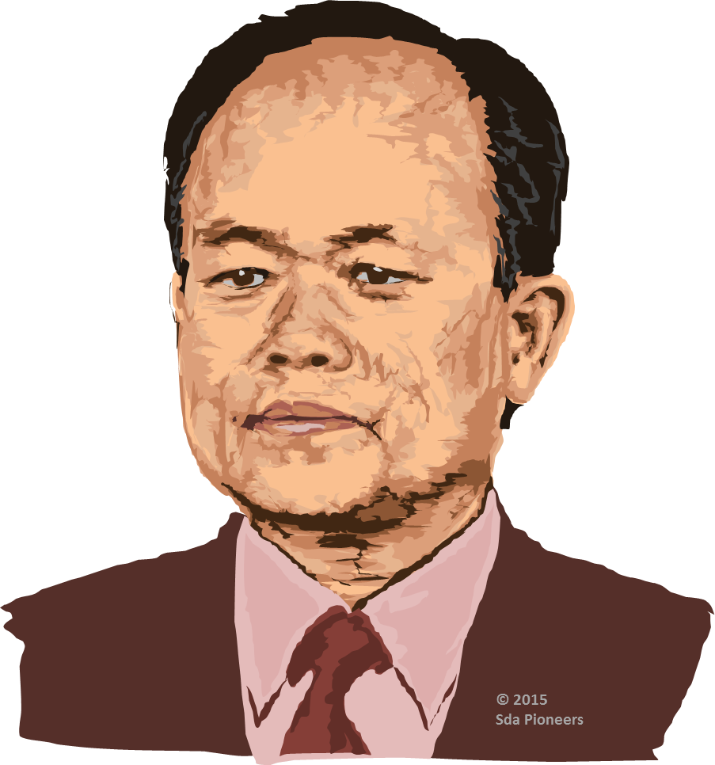


sdapioneers@hotmail.com
Warm and cordial greetings to our brothers and sisters around the world.
Jairyong Lee
President
NORTHERN ASIA-PACIFIC
DIVISION

Slide 25

sdapioneers@hotmail.com
The Thirteenth Sabbath Offering
this quarter will help provide:
four classrooms and a library at
the Adventist school in Mongolia;
an international evangelistic center for
the immigrant population in Japan;
a youth evangelism training center in
South Korea;
house churches in 16 large cities of China;
three centers of influence in Taiwan;
Children’s Project: Books for the school
library in Mongolia.
13

Slide 26
sdapioneers@hotmail.com
2nd Quarter 2015
A Blessed SABBATH

